Slide 1
Build Web Games
Chapter 3: DIV & CSS & JavaScript

Slide 2
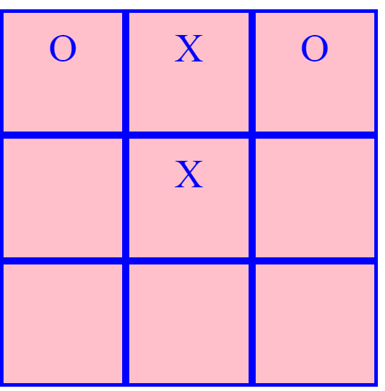
Expected Canvas
Noughts and Cross
border
color font-size
text-align
background-color
height
width

Slide 3
Build canvas
Review HTML document structure
<!DOCTYPE html>
<html>
<head>
<title>
</title>
<style>
</style>
</head>
<body>
</body>
</html>

Slide 4
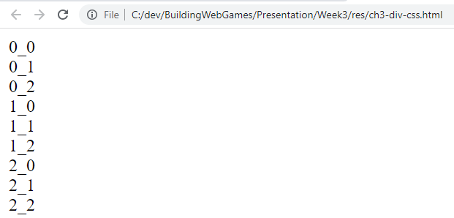
Build canvas – add DIVs
<!DOCTYPE html>
<html>
<head>
<title>
</title>
<style>
</style>
</head>
<body>
</body>
</html>
<body>
<div>0_0</div>
<div>0_1</div>
<div>0_2</div>
<div>1_0</div>
<div>1_1</div>
<div>1_2</div>
<div>2_0</div>
<div>2_1</div>
<div>2_2</div>
</body>

Slide 5

Build canvas – add css
<!DOCTYPE html>
<html>
<head>
<title>
</title>
<style>
</style>
</head>
<body>
</body>
</html>
<style>
div {
border: 3px solid blue;
height: 75px;
width: 75px;
background-color:pink;
color: blue;
text-align: center;
font-size:32px;
}
</style>

Slide 6
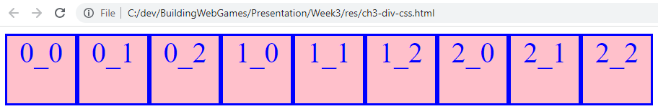
Build canvas – add css
<!DOCTYPE html>
<html>
<head>
<title>
</title>
<style>
</style>
</head>
<body>
</body>
</html>
<style>
div {
border: 3px solid blue;
height: 75px;
width: 75px;
background-color:pink;
color: blue;
text-align: center;
font-size:32px;
float: left;
}
</style>

Slide 7
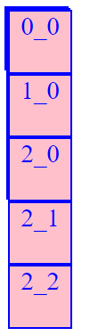
Build canvas – HTML element hierarchy
<!DOCTYPE html>
<html>
<head>
<title>
</title>
<style>
</style>
</head>
<body>
</body>
</html>
<div>
<div>
<div>0_0</div>
<div>0_1</div>
<div>0_2</div>
</div>
<div>
<div>1_0</div>
<div>1_1</div>
<div>1_2</div> </div>
<div>
<div>2_0</div>
<div>2_1</div>
<div>2_2</div> </div>
</div>

Slide 8

Build canvas – HTML element hierarchy
<!DOCTYPE html>
<html>
<head>
<title>
</title>
<style>
</style>
</head>
<body>
</body>
</html>
<div>
<div class="row">
<div>0_0</div>
<div>0_1</div>
<div>0_2</div>
</div>
<div class="row">
<div>1_0</div>
<div>1_1</div>
<div>1_2</div> </div>
<div class="row">
<div>2_0</div>
<div>2_1</div>
<div>2_2</div> </div>
</div
<style>
.row div {
…
}
</style>

Slide 9
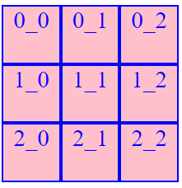
Build canvas – CSS
<!DOCTYPE html>
<html>
<head>
<title>
</title>
<style>
</style>
</head>
<body>
</body>
</html>
<div>
<div class="row">
<div>0_0</div>
<div>0_1</div>
<div>0_2</div>
</div>
<div class="row">
<div>1_0</div>
<div>1_1</div>
<div>1_2</div> </div>
<div class="row">
<div>2_0</div>
<div>2_1</div>
<div>2_2</div> </div>
</div
<style>
.row div {
…
}
.row {
clear: both;
}
</style>

Slide 10
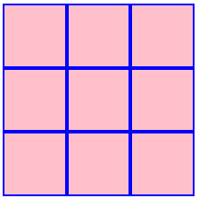
Build canvas – No default texts
<!DOCTYPE html>
<html>
<head>
<title>
</title>
<style>
</style>
</head>
<body>
</body>
</html>
<div>
<div class="row">
<div></div>
<div></div>
<div></div>
</div>
<div class="row">
<div></div>
<div></div>
<div></div>
</div>
<div class="row">
<div></div>
<div></div>
<div></div>
</div>
</div>
<style>
.row div {
…
}
.row {
clear: both;
}
</style>

Slide 11
javascript for interaction
<!DOCTYPE html>
<html>
<head>
<title>
</title>
<style>
</style>
</head>
<body>
<div> </div> <script> </script>
</body>
</html>

Slide 12
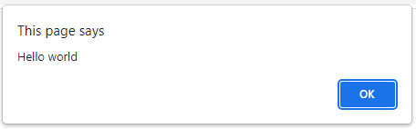
javascript
<!DOCTYPE html>
<html>
<head>
<title>
</title>
<style>
</style>
</head>
<body>
<div> </div> <script> </script>
</body>
</html>
<script>
function onPageLoaded(str) {
window.alert("Hello " + str);
}
onPageLoaded("world");
</script>

Slide 13
javascripT
Key word ‘function’ to define a function
Function name
Function parameter name
function onPageLoaded(str) {
window.alert("Hello " + str);
}
onPageLoaded("world");
window is a built-in object
alert is a method in built-in window object
Function call
Parameter

Slide 14
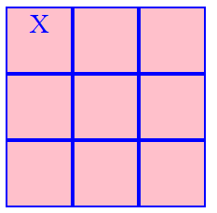
Javascript For interaction
<body>
<div>
<div class="row">
<div onclick="onElementClicked(this)"></div>
<div></div>
<div></div>
</div>
…
</div>
<script>
function onElementClicked(elem) {
elem.innerText = 'X';
}
</script>
</body>

